Slide 1
Unit III--Topic: Tibbles with tibble Sub.Topic: Introduction
A data frame is simply a matrix, but can have columns with different types (numeric, character, logical). Rows are observations (individuals) and columns are variables.
A tibble is a subtype of a data frame that is optimized for data science applications
Tibbles have a refined print method that shows only the first 10 rows, and all the columns that fit on screen. This makes it much easier to work with large data.
library(tidyverse)
install.packages("tibble")
library(tibble)

Slide 2
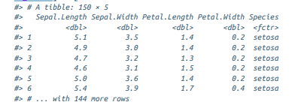
Sub.Topic: Creating Tibbles
Force a data frame to a tibble
as_tibble(iris)

Slide 3
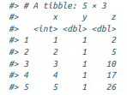
Sub.Topic: Creating Tibbles
tibble( x = 1:5, y = 1, z = x ^ 2 + y )

Slide 4

Sub.Topic: Creating Tibbles
It’s possible for a tibble to have column names that are not valid R variable names
tb <- tibble( `:)` = "smile", ` ` = "space", `2000` = "number" )

Slide 5
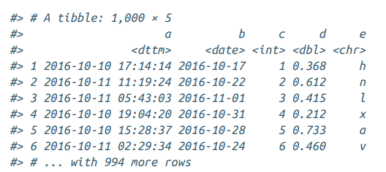
Sub.Topic: Tibbles Versus data.frame
There are two main differences in the usage of a tibble versus a classic data.frame: printing and subsetting.
Printing :Tibbles have a refined print method that shows only the first 10 rows, and all the columns that fit on screen.

Slide 6
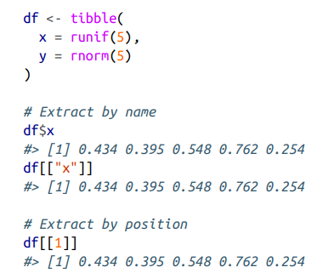
Sub.Topic: Tibbles Versus data.frame
Subsetting :If you want to pull out a single variable, you need some new tools, $ and [[. [[ can extract by name or position;
$ only extracts by name but is a little less typing
Compared to a data.frame, tibbles are more strict: they never do partial matching, and they will generate a warning if the column to access does not exist.

Slide 7
Sub. Topic : Interacting with Older Code
Some older functions don’t work with tibbles.
Use as.data.frame() to turn a tibble back to a data.frame
class(as.data.frame(tb))
#> [1] "data.frame“
The main reason that some older functions don’t work with tibbles

Slide 8
Tibbles with tibble -Exercises
1.How can you tell if an object is a tibble? (Hint: try printing mtcars, which is a regular data frame).
When print mtcars, it prints all the columns
But when we first convert mtcars to a tibble using as_tibble(), it prints on the first ten observations. There are also some other differences in formatting of the printed data frame.
as_tibble(mtcars)
Use the function is_tibble() to check whether a data frame is a tibble or not.
The mtcars data frame is not a tibble.
is_tibble(mtcars)
#> [1] FALSE

Slide 9
Tibbles with tibble -Exercises
But the diamonds and flights data are tibbles.
is_tibble(ggplot2::diamonds)
#> [1] TRUE
is_tibble(nycflights13::flights)
#> [1] TRUE
is_tibble(as_tibble(mtcars))
#> [1] TRUE
More generally, you can use the class() function to find out the class of an object.
class(mtcars)
#> [1] "data.frame"

Slide 10
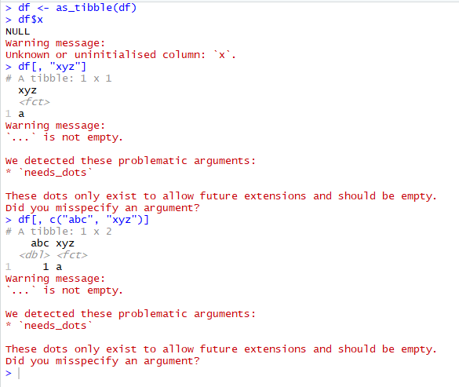
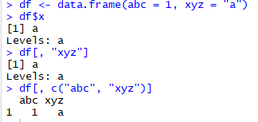
Tibbles with tibble -Exercises
2. Compare and contrast the following operations on a data.frame and equivalent tibble. What is different? Why might the default data frame behaviors cause you frustration?
df <- data.frame(abc = 1, xyz = "a")
df$x
df[, "xyz"]
df[, c("abc", "xyz")]
It works for data frame but error in Tibble

Slide 11
Tibbles with tibble -Exercises
3. If you have the name of a variable stored in an object, e.g. var <- "mpg", how can you extract the reference variable from a tibble?
Use the double bracket, like var[[1]].
Cannot use the dollar sign, because var$mpg would look for a column named mpg.

Slide 12
Tibbles with tibble -Exercises
4. Practice referring to non-syntactic names in the following data frame by:
A. Extracting the variable called 1.
For this example, create a dataset called exampe with columns named 1 and 2.
example <- tibble( `1` = 1:10, `2` = `1` * 2)
To extract the variable named 1:
example[["1"]]
B. Plotting a scatterplot of 1 vs 2.
ggplot(example, aes(x = `1`, y = `2`)) + geom_point()
Creating a new column called 3 which is 2 divided by 1.
Example<-mutate(example, `3` = `2` / `1`)
Renaming the columns to one, two and three.
example <- rename(example, one = `1`, two = `2`, three = `3`)

Slide 13

Tibbles with tibble -Exercises
5. What does tibble::enframe() do? When might you use it?
The function tibble::enframe() converts named vectors to a data frame with names and values
enframe(c(a = 1, b = 2, c = 3))

Slide 14
Tibbles with tibble -Exercises
6. What option controls how many additional column names are printed at the footer of a tibble?
The help page for the print() method of tibble objects is discussed in ?print.tbl. The n_extra argument determines the number of extra columns to print information for.
print(flights)
print(flights,n_extra = 3)

Slide 15
Topic: Data Import with readr Sub.Topic: Introduction
This chapter concern with how to read plain-text rectangular files into R
library(tidyverse)
install.packages(“readr”)
library(readr)

Slide 16
Sub.Topic: Getting Started
Most of readr’s functions are concerned with turning flat files into data frames
readr’s functions
read_csv() reads comma-delimited files
read_csv2() reads semicolon-separated files
read_tsv() reads tab-delimited files
read_delim() reads in files with any delimiter

Slide 17
Sub.Topic: Getting Started
read_fwf() reads fixed-width files.
Specify fields either by their widths with fwf_widths() or their position with fwf_positions().
read_table() reads a common variation of fixed-width files where columns are separated by white space.
read_log() reads Apache style log files.

Slide 18
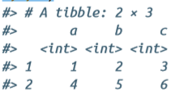
read_csv()
The first argument to read_csv() is the path to the file to read:
heights <- read_csv("data/heights.csv")
Prints out a column specification that gives the name and type of each column
Inline CSV file--for creating reproducible examples
read_csv("a,b,c
1,2,3
4,5,6")

Slide 19


read_csv()
skip = n to skip the first n lines;
or use comment = "#" to drop all lines that start with (e.g.) #:
read_csv("The first line of metadata
The second line of metadata
x,y,z
1,2,3", skip = 2)
read_csv("# A comment I want to skip
x,y,z
1,2,3", comment = "#")

Slide 20
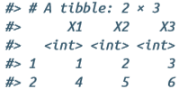
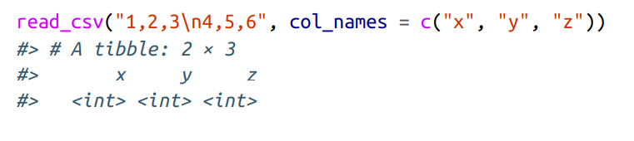
read_csv()
Use col_names = FALSE to tell read_csv() not to treat the first row as headings, and instead label them sequentially from X1 to Xn:
read_csv("1,2,3\n4,5,6", col_names = FALSE)
Pass col_names a character vector,
which will be used as the column names:
read_csv("1,2,3\n4,5,6", col_names = c("x", "y", "z"))

Slide 21

read_csv()
To represent missing values in file:
read_csv("a,b,c\n1,2,.", na = ".")

Slide 22
Compared to Base R
There are a few good reasons to favor readr functions over the base equivalents:
They are typically much faster (~10x) than their base equivalents.
They produce tibbles, and they don’t convert character vectors to factors, use row names, or munge the column names. These are common sources of frustration with the base R functions.
They are more reproducible. Base R functions inherit some behavior from your operating system and environment variables, so import code that works on your computer might not work on someone else’s.

Slide 23
Getting Started –Exercises Refer Video1
1. What function would you use to read a file where fields are separated with “|”?
read_delim(file, delim = "|")
2. Apart from file, skip, and comment, what other arguments do read_csv() and read_tsv() have in common?
Execute the command to know the remaining arguments:
union(names(formals(read_csv)), names(formals(read_tsv)))
[1] "file" "col_names" "col_types"
[4] "locale" "na" "quoted_na“
[7] "quote" "comment" "trim_ws"
[10] "skip" "n_max" "guess_max"
[13] "progress" "skip_empty_rows"

Slide 24
Getting Started –Exercises-- Refer Video1
col_names and col_types are used to specify the column names and how to parse the columns
locale is important for determining things like the encoding and whether “.” or “,” is used as a decimal mark.
na and quoted_na control which strings are treated as missing values when parsing vectors
trim_ws trims whitespace before and after cells before parsing
n_max sets how many rows to read
guess_max sets how many rows to use when guessing the column type
progress determines whether a progress bar is shown

Slide 25
Getting Started –Exercises Refer Video1
3. What are the most important arguments to read_fwf()?
The most important argument to read_fwf() which reads “fixed-width formats”, is col_positions which tells the function where data columns begin and end.

Slide 26

Getting Started –Exercises Refer Video1
4. Sometimes strings in a CSV file contain commas. To prevent them from causing problems they need to be surrounded by a quoting character, like " or '. By convention, read_csv() assumes that the quoting character will be ", and if you want to change it you’ll need to use read_delim() instead. What arguments do you need to specify to read the following text into a data frame?
"x,y\n1,'a,b'“
For read_delim(), need to specify a delimiter, in this case ",", and a quote argument.
x<- "x,y \n 1,'a,b'"
read_delim(x, ",", quote = "'")

Slide 27
Getting Started –Exercises Refer Video1
5. Identify what is wrong with each of the following inline CSV files.
What happens when you run the code?
read_csv("a,b\n1,2,3\n4,5,6")
Only two columns are specified in the header “a” and “b”, but the rows have three columns, so the last column is dropped.
read_csv("a,b,c\n1,2\n1,2,3,4")
The numbers of columns in the data do not match the number of columns in the header (three).
read_csv("a,b\n\"1")
The opening quote "1 is dropped because it is not closed, and a is treated as an integer.

Slide 28
Sub. Topic: Parsing a Vector
These functions take a character vector and return a more specialized vector like a logical, integer, or date:
str(parse_logical(c("TRUE", "FALSE", "NA")))
#> logi [1:3] TRUE FALSE NA
str(parse_integer(c("1", "2", "3")))
#> int [1:3] 1 2 3
str(parse_date(c("2010-01-01", "1979-10-14")))
#> Date[1:2], format: "2010-01-01" "1979-10-14"

Slide 29
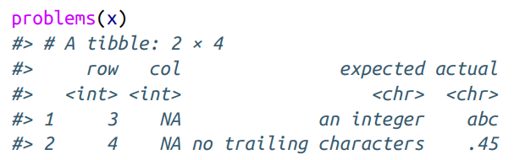
Sub. Topic: Parsing a Vector
na argument specifies which strings should be treated as missing:
parse_integer(c("1", "231", ".", "456"), na = ".")
If parsing fails, get a warning & the failures will be missing in the output
x <- parse_integer(c("123", "345", "abc", "123.45"))
If there are many parsing failures, use problems() to get the complete set.
This returns a tibble, which you can then manipulate with dplyr:
problems(x)

Slide 30
Sub. Topic: Parsing a Vector
There are eight particularly important parsers:
parse_logical() and parse_integer() parse logicals and integers, respectively.
parse_double() is a strict numeric parser, and parse_number() is a flexible numeric parser.
parse_character() to parse characters
parse_factor() creates factors
parse_datetime(), parse_date(), and parse_time() allows to parse various date and time specifications.

Slide 31
Parsing Numbers
Three problems to parse a number,
People write numbers differently in different parts of the world. For example, some countries use . in between the integer and fractional parts of a real number, while others use ,.
Numbers are often surrounded by other characters that provide some context, like “$1000” or “10%”.
Numbers often contain “grouping” characters to make them easier to read, like “1,000,000”, and these grouping characters vary around the world.

Slide 32
Parsing Numbers
To address the first problem, readr has the notion of a “locale,” and setting the decimal_mark argument:
parse_double("1.23")
#> [1] 1.23
parse_double("1,23", locale = locale(decimal_mark = ","))
#> [1] 1.23

Slide 33
Parsing Numbers
parse_number() addresses the second problem: it ignores nonnumeric characters before and after the number
parse_number("$100")
#> [1] 100
parse_number("20%")
#> [1] 20
parse_number("It cost $123.45")
#> [1] 123

Slide 34
Parsing Numbers
The final problem is addressed by the combination of parse_num ber() and the locale as parse_number() will ignore the “grouping mark”:
# Used in America
parse_number("$123,456,789")
#> [1] 1.23e+08
# Used in many parts of Europe
parse_number( "123.456.789", locale = locale(grouping_mark = ".") )
#> [1] 1.23e+08
# Used in Switzerland
parse_number( "123'456'789", locale = locale(grouping_mark = "'") )
#> [1] 1.23e+08

Slide 35
Parsing Strings
Representation of a string using charToRaw():
charToRaw("Hadley")
#> [1] 48 61 64 6c 65 79
Each hexadecimal number represents a byte of information: 48 is H, 61 is a, and so on.
The encoding is called ASCII (American Standard Code for Information Interchange)
UTF-8 can encode just about every character used by humans today, as well as many extra symbols (like emoji!).
readr uses UTF-8 everywhere: it assumes data is UTF-8 encoded when read it, and always uses it when writing.

Slide 36
Parsing Strings
For example:
x1 <- "El Ni\xf1o was particularly bad this year“
x2 <- "\x82\xb1\x82\xf1\x82\xc9\x82\xbf\x82\xcd“
To fix the problem specify the encoding in parse_char acter():
parse_character(x1, locale = locale(encoding = "Latin1"))
#> [1] "El Niño was particularly bad this year“
parse_character(x2, locale = locale(encoding = "Shift-JIS"))
#> [1] " こんにちは “

Slide 37
Parsing Strings
readr provides guess_encoding() to find the correct encoding
guess_encoding(charToRaw(x1))
#> encoding confidence
#> 1 ISO-8859-1 0.46
#> 2 ISO-8859-9 0.23
guess_encoding(charToRaw(x2))
#> encoding confidence
#> 1 KOI8-R 0.42

Slide 38
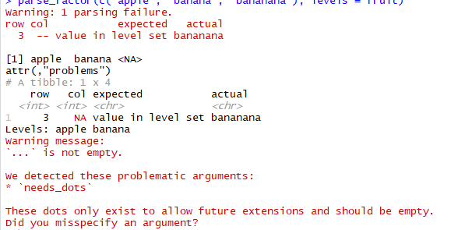
Parsing Factors
R uses factors to represent categorical variables that have a known set of possible values.
parse_factor() a vector of known levels to generate a warning whenever an unexpected value is present:
fruit <- c("apple", "banana")
parse_factor(c("apple", "banana", "bananana"), levels = fruit)

Slide 39
Dates, Date-Times, and Times Refer Video 2
parse_datetime() expects an ISO8601 date-time.
ISO8601 is an international standard in which the components of a date are organized from biggest to smallest: year, month, day, hour, minute, second:
parse_datetime("2010-10-01T2010")
#> [1] "2010-10-01 20:10:00 UTC"
# If time is omitted, it will be set to midnight
parse_datetime("20101010")
#> [1] "2010-10-10 UTC"

Slide 40
Dates, Date-Times, and Times- Refer Video 2
parse_date() expects a four-digit year, a - or /, the month, a or /, then the day:
parse_date("2010-10-01")
#> [1] "2010-10-01"
parse_time() expects the hour, :, minutes, optionally : and seconds, and an optional a.m./p.m. specifier:
library(hms)
parse_time("01:10 am")
#> 01:10:00
parse_time("20:10:01")
#> 20:10:01
Base R doesn’t have a great built-in class for time data, so we use the one provided in the hms package.

Slide 41
Dates, Date-Times, and Times– Refer Video 2
date-time format:
Year %Y (4 digits).
%y (2 digits; 00-69 → 2000-2069, 70-99 → 1970-1999).
Month %m (2 digits).
%b (abbreviated name, like “Jan”).
%B (full name, “January”).
Day %d (2 digits).
parse_date("01/02/15", "%m/%d/%y")
#> [1] "2015-01-02"

Slide 42
Sub. Topic: Parsing a Vector --Exercisesc
1. What are the most important arguments to locale()?
The locale object has arguments to set the following:
date and time formats: date_names, date_format, and time_format
time zone: tz
numbers: decimal_mark, grouping_mark
encoding: encoding

Slide 43
Sub. Topic: Parsing a Vector --Exercises
2. What happens if you try and set decimal_mark and group ing_mark to the same character? What happens to the default value of grouping_mark when you set decimal_mark to ",“? What happens to the default value of decimal_mark when you set the grouping_mark to ".“?
If the decimal and grouping marks are set to the same character, locale throws an error:
locale(decimal_mark = ".", grouping_mark = ".")
If the decimal_mark is set to the comma ",", then the grouping mark is set to the period ".":
locale(decimal_mark = ",")
If the grouping mark is set to a period, then the decimal mark is set to a comma
locale(grouping_mark = ".")

Slide 44
Sub. Topic: Parsing a Vector --Exercises
3. I didn’t discuss the date_format and time_format options to locale(). What do they do? Construct an example that shows when they might be useful.
Both the date format and time format are used for guessing column types.
locale_custom <- locale(date_format = "Day %d Mon %M Year %y", time_format = "Sec %S Min %M Hour %H")
date_custom <- c("Day 01 Mon 02 Year 03", "Day 03 Mon 01 Year 01")
parse_date(date_custom)
parse_date(date_custom, locale = locale_custom)
parse_time(time_custom)
parse_time(time_custom, locale = locale_custom)

Slide 45
Sub. Topic: Parsing a Vector --Exercises
4. Generate the correct format string to parse each of the following dates and times:
d1 <- "January 1, 2010"
parse_date(d1, "%B %d, %Y")
d2 <- c("August 19 (2015)", "July 1 (2015)")
parse_date(d2, "%B %d (%Y)")
t2 <-"11:15:10.12 PM"
parse_time(t2, "%H:%M:%OS %p")

Slide 46
Sub. Topic: Parsing a File- Strategy
readr uses a heuristic to figure out the type of each column:
it reads the first 1000 rows and uses some heuristics to figure out the type of each column.
guess_parser(), which returns readr’s best guess,
parse_guess(), which uses that guess to parse the column
guess_parser("2010-10-01")
#> [1] "date“
guess_parser("15:01")
#> [1] "time"

Slide 47
Sub. Topic: Parsing a File- Strategy
guess_parser(c("TRUE", "FALSE"))
#> [1] "logical"
guess_parser(c("1", "5", "9"))
#> [1] "integer“
guess_parser(c("12,352,561"))
#> [1] "number"
str(parse_guess("2010-10-10"))
#> Date[1:1], format: "2010-10-10"

Slide 48
Sub. Topic: Parsing a File- Strategy
The heuristic tries each of the following types, stopping when it finds a match:
logical Contains only “F”, “T”, “FALSE”, or “TRUE”.
integer Contains only numeric characters (and -).
double Contains only valid doubles (including numbers like 4.5e-5).
number Contains valid doubles with the grouping mark inside.
time Matches the default time_format.
date Matches the default date_format.
date-time Any ISO8601 date.
If none of these rules apply, then the column will stay as a vector of strings.

Slide 49
Problems
These defaults don’t always work for larger files. There are two basic problems:
The first thousand rows might be a special case, and readr guesses a type that is not sufficiently general.
For example, column of doubles that only contains integers in the first 1000 rows.
Second, The column might contain a lot of missing values.
If the first 1000 rows contain only NAs, readr will guess that it’s a character vector, whereas parse it as something more specific.
readr contains a challenging CSV that illustrates both of these problems:
challenge <- read_csv(readr_example("challenge.csv"))
readr_example(), which finds the path to one of the files included with the package.
problems(challenge)

Slide 50
Strategy
A good strategy is to work column by column until there are no problems remaining.
Here there are a lot of parsing problems with the x column—there are trailing characters after the integer value.
That suggests , need to use a double parser instead.
To fix the call, start by copying and pasting the column specification into original call:
challenge <- read_csv( readr_example("challenge.csv"), col_types = cols( x = col_integer(), y = col_character() ) )
Then tweak the type of the x column:
challenge <- read_csv( readr_example("challenge.csv"), col_types = cols( x = col_double(), y = col_character() ) )

Slide 51
Strategy
That fixes the first problem, but if we look at the last few rows, you’ll see that they’re dates stored in a character vector:
tail(challenge)
You can fix that by specifying that y is a date column:
challenge <- read_csv( readr_example("challenge.csv"), col_types = cols( x = col_double(), y = col_date()))

Slide 52
Other Strategies
There are a few other general strategies to help parse files:
In the previous example, just one more row than the default, can correctly parse in one shot:
challenge2 <- read_csv( readr_example("challenge.csv"), guess_max = 1001)
Data frame: df <- tribble( ~x, ~y, "1", "1.21", "2", "2.32", "3", "4.56" )
df
type_convert(df)
If reading a very large file, set n_max like 10,000 or 100,000.

Slide 53
Sub. Topic: Writing to a File— Refer Video 3
write_csv() and write_tsv()
Both functions increase the chances of the output file being read back in correctly by:
Always encoding strings in UTF-8.
Saving dates and date-times in ISO8601 format so they are easily parsed elsewhere.
To export a CSV file to Excel, use write_excel_csv()
write_csv(challenge, "challenge.csv")
Note that the type information is lost when you save to CSV:
Challenge

Slide 54
Sub. Topic: Writing to a File— Refer Video 3
write_csv(challenge, "challenge-2.csv")
read_csv("challenge-2.csv")
Need to re-create the column specification every time load in
There are two alternatives:
write_rds() and read_rds() are uniform wrappers around the base functions readRDS() and saveRDS().
These store data in R’s custom binary format called RDS
write_rds(challenge, "challenge.rds")
read_rds("challenge.rds")

Slide 55
Sub. Topic: Other Types of Data--- Refer Video 3
To get other types of data into R-- starting with the tidyverse packages
For rectangular data:
haven reads SPSS, Stata, and SAS files.
readxl reads Excel files (both .xls and .xlsx).
DBI, along with a database-specific backend (e.g., RMySQL, RSQLite, RPostgreSQL, etc.) allows to run SQL queries against a database and return a data frame.

